Slide 1
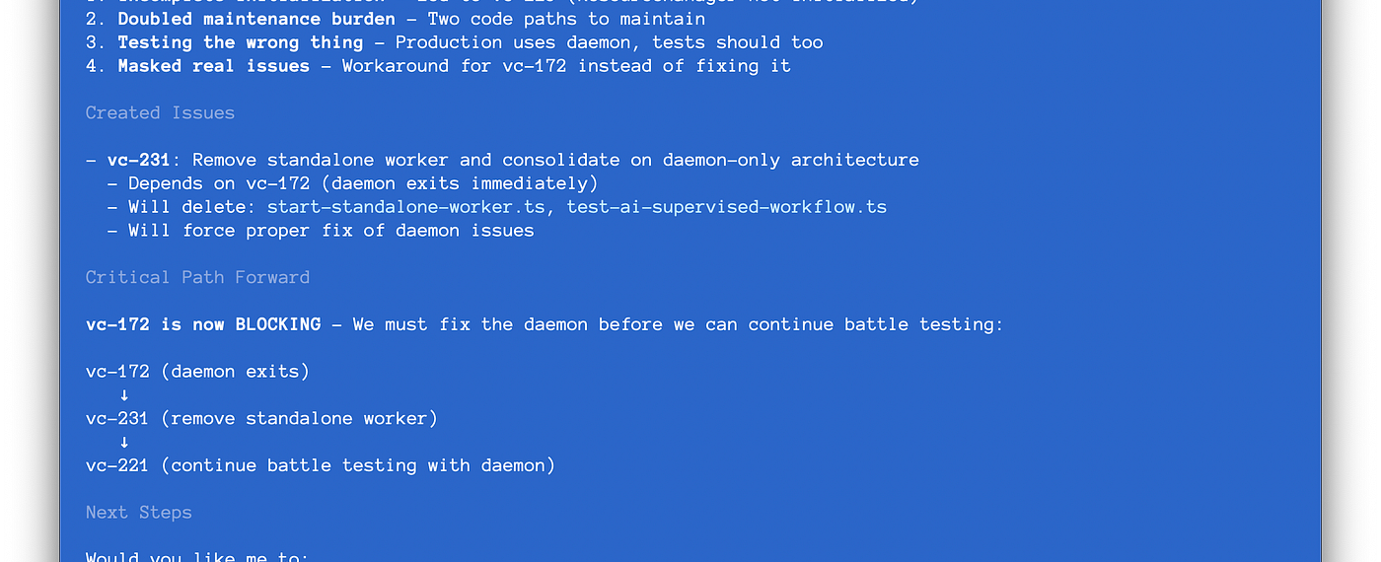
STEVE YEGGE · INTRODUCING BEADS · 2025
605 markdown plan files
“in varying stages of decay” — Steve Yegge
AI Engineering Fridays · 1
Notes:
Open with Yegge's number, then pause: he did not reject Markdown from the outset. He went all-in on Git-versioned, hierarchical Markdown plans for agent orchestration—and eventually found 605 plan files in varying stages of decay.
Use the screenshot as evidence: the agent has created a follow-up issue, recorded what it depends on, and made the critical path explicit. This is the move from plans as documents to work as queryable state.
Bridge to slide 2: ordinary plan mode is still a strong workflow for bounded work inside one session. The problem appears when that work must survive restarts, discoveries, nesting, and hand-offs.
Accuracy note: the launch essay describes Beads' historical JSONL implementation. Current technical claims later in the deck use the modern Dolt-based documentation.
[Sources]
- Steve Yegge, Introducing Beads: A coding agent memory system, 13 October 2025: https://steve-yegge.medium.com/introducing-beads-a-coding-agent-memory-system-637d7d92514a
- Original image from the essay: https://miro.medium.com/v2/resize:fit:1400/1*HbBoe7lEio9gX6v6-ZFbZQ.png
- Visual template: Agentic AI workflows — adoption stages + workflow descriptions.pptx
[/Sources]

Slide 2
AI ENGINEERING FRIDAYS · THE FAMILIAR FLOW
The familiar Claude Code loop
PLAN MODE
Read + propose
REVIEW
Refine + approve
EXECUTE
Edit + run
VERIFY
Review the result
→
→
→
A strong workflow for bounded work inside one session
AI Engineering Fridays · 2
Notes:
Start from the audience’s normal experience. In Plan Mode Claude reads and explores without editing source files, presents a plan, and begins editing after approval in the selected permission mode. Say plainly that this workflow is useful and is not the problem.
[Sources]
- https://code.claude.com/docs/en/permission-modes
- Visual template: Agentic AI workflows — adoption stages + workflow descriptions.pptx
[/Sources]

Slide 3
AI ENGINEERING FRIDAYS · THE PRESSURE POINTS
Real work escapes the session
Markdown can carry this—but each pressure adds another convention.
WHAT HAPPENS?
THE PLAN NOW NEEDS
Several sessions
→
State
Work continues tomorrow
New work appears
→
Provenance
Execution reveals a bug
Dependencies
→
A graph
Task B waits for Task A
A hand-off
→
Memory
Another session takes over
IDs · status · ownership · dependencies · provenance · hand-off context
AI Engineering Fridays · 3
Notes:
Let the complexity emerge through questions: What is done? What is next? Where does the bug belong? What is blocked? How does a fresh session know why? Acknowledge that Markdown can encode all of this. The point is that we are progressively designing task-management conventions inside the document.
[Sources]
- Visual template: Agentic AI workflows — adoption stages + workflow descriptions.pptx
[/Sources]

Slide 4
AI ENGINEERING FRIDAYS · BEADS
Beads makes the work state explicit
bd prime
restore context
bd ready
find work
bd show
inspect
bd update
claim + record
bd close
hand off
→
→
→
→
Discovered work becomes a linked bead—not a lost note
AI Engineering Fridays · 4
Notes:
Introduce beads only now. It is a persistent, dependency-aware task graph designed for AI-supervised coding workflows. The agent can restore project context, find unblocked work, inspect one bounded unit, claim it, record discovered work with provenance, and leave a durable hand-off.
[Sources]
- https://github.com/gastownhall/beads/blob/main/docs/index.md
- https://github.com/gastownhall/beads/blob/main/docs/getting-started/ide-setup.md
- https://github.com/gastownhall/beads/blob/main/docs/multi-agent/coordination.md
- Visual template: Agentic AI workflows — adoption stages + workflow descriptions.pptx
[/Sources]

Slide 5
AI ENGINEERING FRIDAYS · LIVE DEMO
A short beads loop
A fresh session can recover context and leave the next one a clean hand-off.
COMMAND
RESULT
bd prime
1
Orient
Load workflow + project memory
bd ready
2
Choose
Find work with no open blockers
bd show <id>
3
Understand
Inspect one bounded task
update · create · close
4
Continue
Act, record discoveries, hand off
The task graph survives even when the conversation does not.
AI Engineering Fridays · 5
Notes:
Switch to the terminal. Run the prepared demo from presentation/demo-runbook.md. Keep this to roughly three minutes. If the live agent response stalls, use the deterministic CLI path and continue; the audience still sees the same persisted context and task graph.
[Sources]
- https://github.com/gastownhall/beads/blob/main/docs/index.md
- Local demo runbook: presentation/demo-runbook.md
- Visual template: Agentic AI workflows — adoption stages + workflow descriptions.pptx
[/Sources]

Slide 6
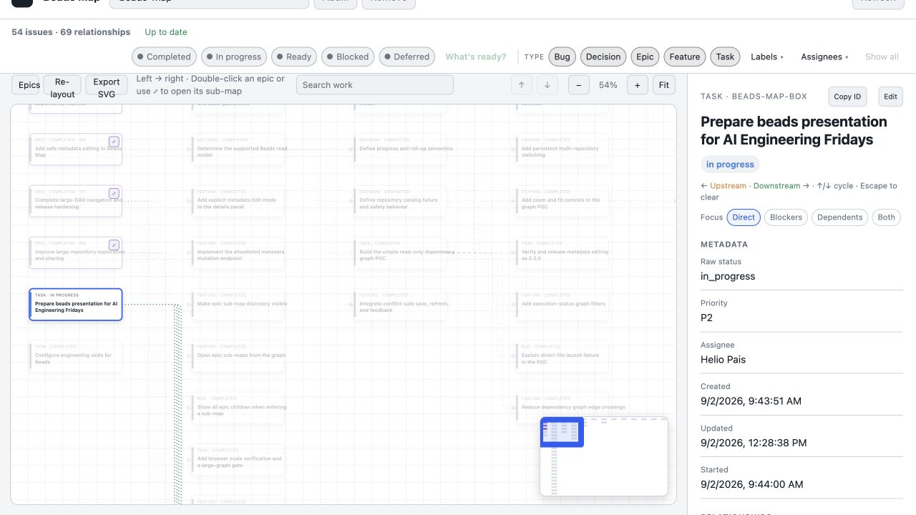
AI ENGINEERING FRIDAYS · BEADS MAP
Beads Map makes the hand-off visible
AI Engineering Fridays · 6
Notes:
Show the presentation task selected with its children, state, description, acceptance criteria, design, and notes. The opening slide already established the repository-level view; here, zoom into one durable hand-off.
[Sources]
- Local screenshot captured from beads-map on 2026-09-02: presentation/assets/beads-map-presentation-work.png
- Visual template: Agentic AI workflows — adoption stages + workflow descriptions.pptx
[/Sources]

Slide 7
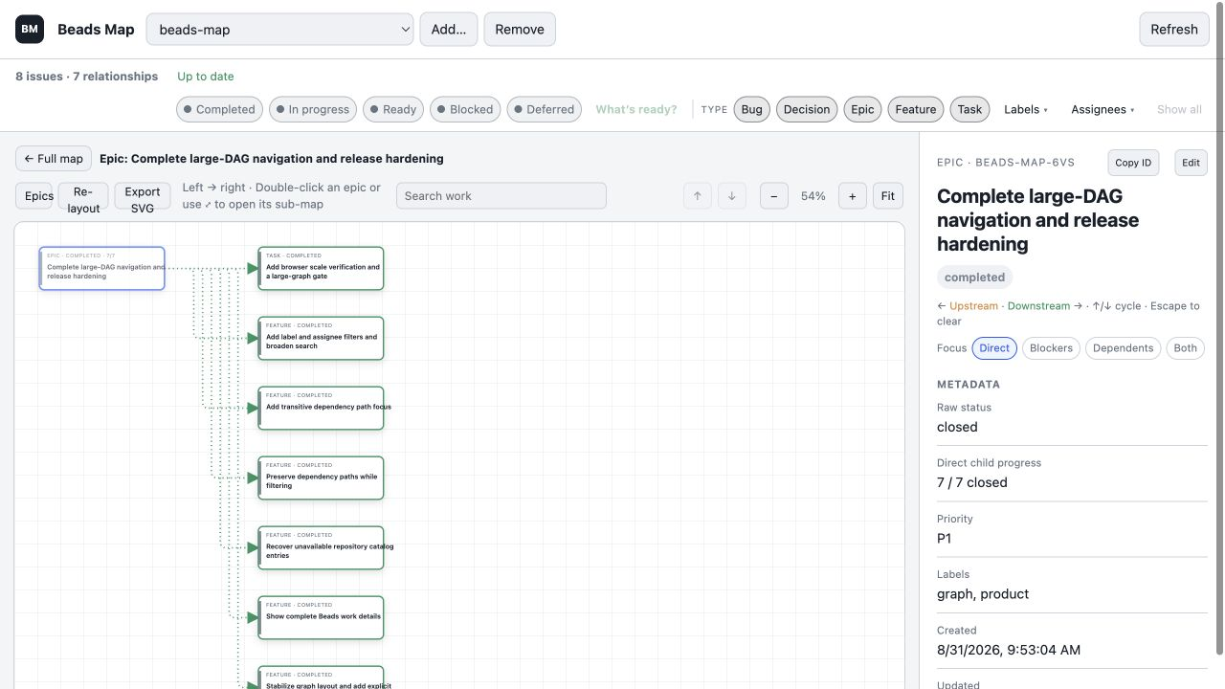
AI ENGINEERING FRIDAYS · PROOF
49 completed beads in seven days
AI Engineering Fridays · 7
Notes:
This is not a benchmark or a causal productivity claim. It is a traceable project history: 49 beads were closed between 25 and 31 August 2026, spanning product decisions, implementation, bugs, packaging, and release hardening. The visualizer shown here was built through the system it visualizes.
[Sources]
- Local bd stats and closed-issue records inspected 2026-09-02
- Local screenshot captured from beads-map on 2026-09-02: presentation/assets/beads-map-release-hardening.png
- Visual template: Agentic AI workflows — adoption stages + workflow descriptions.pptx
[/Sources]

Slide 8
AI ENGINEERING FRIDAYS · YOUR TURN
Try it—and let me know
Start with one real task that will still matter tomorrow.
FIRST EXPERIMENT
OUTCOME
Install
1
Once
brew install beads
Initialize
2
Scope
bd init inside one repository
Resume
3
Context
bd prime in a fresh session
Tell me
↗
Feedback
What worked? What got in the way?
Use beads where the work—not merely the chat—needs continuity.
AI Engineering Fridays · 8
Notes:
Close without overselling. Ask people to try beads on one genuine multi-session task and tell you where it helps or adds friction. Leave the final slide visible for questions.
[Sources]
- https://github.com/gastownhall/beads/blob/main/docs/index.md
- Visual template: Agentic AI workflows — adoption stages + workflow descriptions.pptx
[/Sources]

